Slide 1
IVEY
INCLUSIVE
COMMUNITY
PLANNING
TOOL
v.2.0
Dr. Erin Huner
Director, Culture & Inclusion
Ladan Mowlid,
Senior EDI Program Associate

Slide 2
Land Acknowledgement
The Ivey Business School is located on the traditional territory of the Anishinaabek (Ah-nish-in-a-bek), Haudenosaunee (Ho-den-no-show-nee), Lūnaapéewak (Len-ahpay-wuk) and Chonnonton (Chun-ongk-ton) Nations.
As visitors to this land, we acknowledge the responsibilities given to us through the Dish With One Spoon Covenant Wampum. The bowl that centres the teaching of this Wampum, holds a series of responsibilities for how to live in a good way. We recognize that we are asked to live in reciprocity with the birds, the plants, animals, waters, rocks and one another, as the ethics and values by which we all live within this bowl. We also recognize that as visitors, we collectively eat with one spoon, and therefore we must only take what we need from the bowl, and that maintaining the balance of the bowl is a responsibility we all hold and must maintain.

Slide 3
ACKNOWLEDGEMENTS
We want to thank the Ivey community for participating in the design process for the creation of this tool. We learned so much from each member of the community that has taken the time to use this tool; tell us about their experiences with the tool; and how we could continue to refine the design for the community.
A Note on Version 2.0:
In this version of the Ivey Inclusive Community Planning Tool, we have worked to increase the accessibility of the tool, by integrating best practices for accessible design. We know this work is never complete. So, you will see new versions of this tool emerge as we continue our practice of learning and unlearning a

Slide 4
Who We Are
Ladan (Luh-than) Mowlid (Mow-Leed)
My pronouns are (she/her) and I identify as a Black Muslim woman born to East African parents who immigrated to Canada. I am the first in my immediate family to pursue post-secondary studies. My lived experiences navigating healthcare, government and educational systems stem from growing up translating for my parents, community members and mentoring other first-generation youth. Although there were and often are, many challenges that come with embodying these identities, those are ultimately the lived experiences that have shaped my path as an EDI and Student Affairs practitioner.
Erin (Air-In) Huner (Hugh-ner)
My pronouns are (she/her) and I identify as a white, first-generation settler to Canada. I am a social geographer who works at the intersections of health, ethics and the environment. I am also the mother of, and co-advocate with, my neurodivergent son. I support my son as he navigates the systemic inequalities and inaccessibilities of the educational, governmental and healthcare systems in Canada. These are the lived experiences that have shaped my path as an EDI inclusion researcher and practitioner.

Slide 5
Welcome to the Ivey Inclusive Community Planning Tool
This inclusive community planning tool was designed in collaboration with members of the Ivey community, in order to support all members of our community to engage in planning that incorporates the following 3 principles:
Understanding our positionality:
This tool, along with all of the tools you will find in Ivey’s EDI toolkit, start by asking users to take a moment to identify their positionality by examining how their social identities are constructed. Understanding the place from which you speak, and how this place might be different from your community peers, and community members and colleagues, is an important place to start the work of planning and thinking in inclusive ways.

Slide 6
2) Proactive Accommodations:
Instead of placing the responsibility of seeking accommodations on the members of our community for whom accommodations are necessary, this planning tool asks you, as the planner, to consider how you can proactively plan for incorporating accommodations that will make your event accessible in your design process from conception to execution. By doing so, we are committing to our Ivey community that we will think as broadly and as diversely as we can when we approach the planning of events and programs.

Slide 7
3) Consultation:
Understanding that we can never know the complexity of how a community member’s social identity may affect their ability to engage with community events and programs, we commit to engage in planning that consults widely across our Ivey community, to ensure we are planning with our community, not for our community.

Slide 8
We hope this tool is useful to you as you engage in community planning that supports an inclusive, diverse, innovative and exciting series of events and programs! We also recognize that this is a living document, and that we may have missed important questions that our community needs to consider.
If you would like to add any questions or if you would like to talk to us about any aspect of inclusion and accessibility that you think is missing from this tool, please reach out. You can contact Erin Huner, Director, Culture & Inclusion (ehuner@ivey.ca).

Slide 9
Let’s get started!

Slide 10
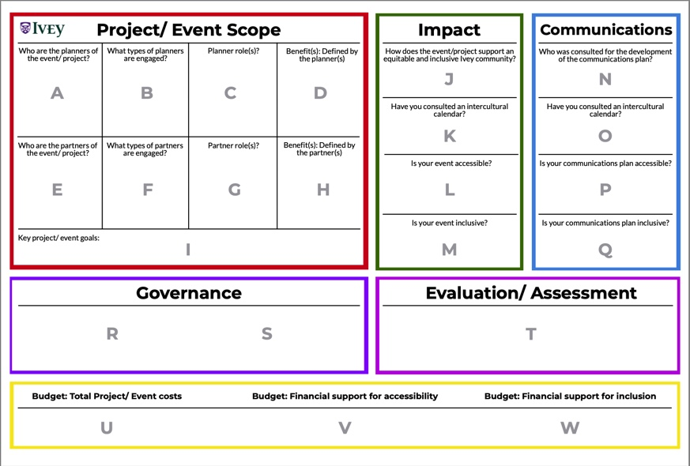

Slide 11
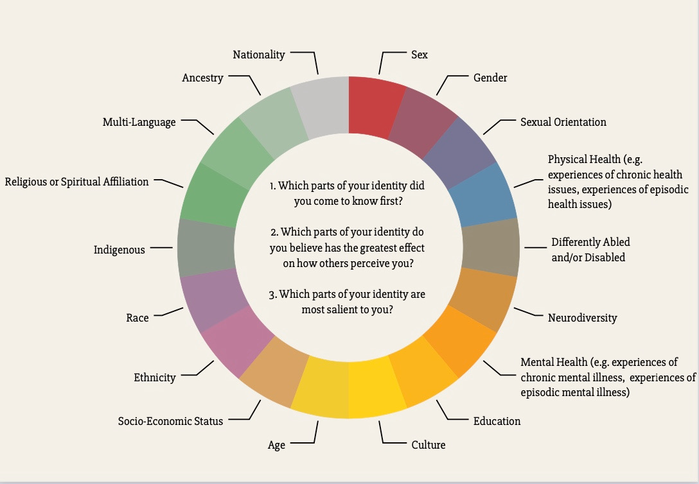
STEP 1: Positionality
Take a few moments to complete the following social identity wheel. Think about the places on this wheel you find your own identity.
This social identity wheel will support you in identifying and uncovering the intersecting and complex components that construct your social identity. Some aspects may be well understood as you work your way through this exercise; other social identities may be emerging; and some you may have not considered.
This is self-paced work, and the goal is to reflect as you make your way through this exercise about the multidimensional and intersectional ways your social identity is constructed, and the parts of this social identity you feel comfortable sharing.
You will use this information as you begin to work through using the Inclusive planning tool.

Slide 12
STEP 2: Part 1: Project/Event Scope
In this next part of the workbook, we will be talking about sections A to I, which are located in the Project/Event Scope section of the Planning Canvas, which is outlined in the colour red.

Slide 13
STEP 2: Part 1: Project/Event Scope
Section A:
Thinking about the social identity wheel exercise you have completed; can you begin to talk with your peers about how you identify your social identities? What is common about your identities? What is uncommon? Do you have more aspects of your identity in common or not in common on the planning committee?
Section E:
Do you have partners in this event? Here, partners could be defined as a group of individuals that will engage in the planned event, that may or may not be directly involved in the planning.
If you know the social identities of the partners, are they aligned with the identities of the planning committee? Or are the partner’s identities more diverse than the planning committee?
ASK YOURSELF:
Have you thought about social identities that encompass: Racial Identity; Ethnocultural Identity; Religious Identity; Neurodiversity; Age; Gender; Sexuality and Sexual Orientation; Physical Ability and Accessibility and Socio-economic status?

Slide 14
STEP 2: Part 1: Project/Event Scope
Section E continued:
If your partners are not well represented on the planning committee, can you think about ways in which you need to expand your planning committee to include a more diverse set of social identities and voices so that you are not planning FOR your partners, but WITH your partners?
ASK YOURSELF:
Whose perspective might be missing on our planning committee?

Slide 15
STEP 2: Part 1: Project/Event Scope
ASK YOURSELF:
Do they have a mandate to represent peers or colleagues in some way?
What is the diversity of the skills on your planning committee?
What are the accountabilities of the planning committee?
To whom are you accountable?
SECTION B:
When you think about who is included in your planning committee, what power do they hold? Are they elected peers in student government or clubs? Are they colleagues who sit on formal committees?
Take a moment to map out any accountability lines members of your planning committee might have.

Slide 16
STEP 2: Part 1: Project/Event Scope
SECTION F:
Thinking about your planning committee, are there partners involved?
SECTION D:
How will your planning committee describe the benefits of the program/event you are planning?
ASK YOURSELF:
What roles do the partners hold in the planning process?
What accountabilities do the partners have?
Have you included partner voices in the description of these benefits?
How will the planning committee be accountable to the participants of the event/program with respect to ensuring the stated benefits occur?

Slide 17
STEP 2: Part 1: Project/Event Scope
ASK YOURSELF:
Have you engaged with partners who are: Neurodiverse; diverse gendered identities; diverse sexual orientations; diverse ages; diverse physical abilities and diverse socio-economic backgrounds have diverse racialized identities; diverse ethnocultural identities; diverse religious identities?
Remember! Diverse representation is required to plan inclusively.
SECTION D:
When you think about the description of the stated benefits: have you considered if these benefits will be accessible to a diverse set of participants?
SECTION H:
How have your partners defined the benefits of your event/program?

Slide 18
STEP 2: Part 1: Project/Event Scope
ASK YOURSELF:
Where are these descriptions in alignment with the planning committee?
Are there places where there is difference in perspective between the committee and partners?
If there is difference in perspective, how will you engage to build consensus?
SECTION I:
Thinking about what you have learned by engaging with your committee and your partners, identify the key goals of your program/event.

Slide 19
STEP 2: Part 2: Impact
In this next part of the workbook, we will be talking about sections J to M, which are located in the Impact section of the Planning Canvas, which is outlined in the colour green.

Slide 20
STEP 2: Part 2: Impact
ASK YOURSELF:
Thinking about what you’ve learned about your program/event scope from your partners, how have you come to know/understand about what is equitable and inclusive from your partner’s perspective(s)?
How does the information you gathered in sections E/F/G/H and I help you understand the ways in which your event supports equity and inclusion in your Ivey community?
SECTION J:
When you think about what you’ve learned about your partners (sections E/F/G/H) and the goal(s) of the event (section I), how does the goal of your project support the equity and inclusion of your Ivey community?

Slide 21
STEP 2: Part 2: Impact
SECTION K:
Looking at the intercultural calendar (link below), are there any intercultural observances that are intersecting with the date you have chosen for your event/program?
https://www.diversityresources.com/2022-diversity-calendar/
ASK YOURSELF:
How can your event proactively accommodate members of your community who may have intercultural observances that intersect with the timing of your planned event or program?

Slide 22
STEP 2: Part 2: Impact
SECTION L:
Public transport is often the most accessible and cost-effective method of transportation for community members with many social identities, such as: international students, students from lower socioeconomic status (SES) communities, communities with physical disabilities, and communities of students who are living in London for school who may not have access to a car.
https://www.londontransit.ca/plan-a-trip/routes-schedules/
ASK YOURSELF:
Have you consulted the Public Transportation map, when considering your event location?
Is the location accessible by public transportation both at the beginning and end of the event?

Slide 23
STEP 2: Part 2: Impact
ASK YOURSELF:
When community members arrive at the destination of the program/event, have you considered the accessibility requirements that are needed for participants with differing abilities: for instance, stairs. Is there an alternative to the stairs?
washroom locations, is the accessible washroom easily accessible for a person with a physical disability?
walking distance from the closest bus stop, etc.
SECTION L continued:
Public transport is often the most accessible and cost-effective method of transportation for community members with many social identities, such as: international students, students from lower socioeconomic status (SES) communities, communities with physical disabilities, and communities of students who are living in London for school who may not have access to a car.
https://www.londontransit.ca/plan-a-trip/routes-schedules/

Slide 24
STEP 2: Part 2: Impact
ASK YOURSELF:
Have you ensured that you have accessible washrooms from a physical accessibility standpoint and within proximity to the event/program?
Have you also ensured that there are available gender-neutral washrooms? A tip for program/event planners: typically, a singular, lockable, accessible bathroom can be used to accommodate the need for gender neutral washrooms.
SECTION L continued:
In the planning of the program/event, have you thought of proactive accommodations for community members who may have physical accessibility requirements (think about your partners in sections E/F/G/H)?

Slide 25
STEP 2: Part 2: Impact
ASK YOURSELF:
Have you considered proactively including food for those who have religious, allergy and/or personal dietary restrictions?
Another consideration to reflect on is whether alcoholic beverages are being served. If so, it is important to note that this should prompt further discussions with your partners about how serving alcoholic beverages may impact the inclusion for your
event for the Ivey community.
SECTION M:
Is this event inclusive for various social-cultural identities that are represented by your identified partners in sections (E/F/G/H)? And have you thought about the broader Ivey community?

Slide 26
STEP 2: Part 2: Impact
ASK YOURSELF:
Have you ensured, to the best of your ability, that the people who are running and supporting the event hold diversity that’s reflective of the group who is coming (sections E/F/G/H)? For instance, what are the identities of the event/program staff including the greeters, speakers, food handlers, etc.?
Is your event inclusive to a broad range of socioeconomic backgrounds? What have you done to address any prohibitive financial costs required to participate in the planned program?
SECTION M continued:
Is this event inclusive for various social-cultural identities that are represented by your identified partners in sections (E/F/G/H)?

Slide 27
STEP 2: Part 2: Impact
ASK YOURSELF:
If this event spans over a few hours, a full day or is a multi-day agenda, have you considered the needs of those participants who may be required to participate in obligatory religious practices? For example, have you considered the need for a prayer space for Muslim community members? This is a proactive accommodation that will model to your community that these necessities have already been considered and taken care of before the event begins.
SECTION M continued:
Is this event inclusive for various social-cultural identities that are represented by your identified partners in sections (E/F/G/H)?

Slide 28
STEP 2: Part 2: Impact
ASK YOURSELF:
If there will be music playing at your event/program, can you think about the sociocultural impact the lyrics may have? Here is a tip: read the lyrics out loud and see how it sounds as a poem. Read it to your planning group and see the reactions of both the committee members and the partners you’ve included in this process. Another tip: Spotify and Apple have campus-friendly playlists for community program/events.
https://open.spotify.com/album/2q5nhxyM2icNrbx4c2KyRp
SECTION M continued:
Is this event inclusive for various social-cultural identities that are represented by your identified partners in sections (E/F/G/H)?

Slide 29
STEP 2: Part 3: Communication
In this next part of the workbook, we will be talking about sections N to Q, which are located in the Communications section of the Planning Canvas, which is outlined in the colour blue.

Slide 30
STEP 2: Part 3: Communication
ASK YOURSELF:
When you developed your communications plan, did you consult widely with a group of people who hold a diverse set of identities to ensure that the communications, images, and the spaces you intend to promote the communications are accessible and inclusive (think about sections E/F/G/H) and your partners?
Section N:
Are you using proactive communication for the planning of your event/program?

Slide 31
STEP 2: Part 3: Communication
ASK YOURSELF:
Have you consulted an intercultural calendar?
https://www.diversityresources.com/2022-diversity-calendar/
Have you used AODA standards?
https://aoda.ca/what-are-aoda-standards/
Is your printed material voice to text compliant, and accessible across a number of platforms? https://www.microsoft.com/en-us/accessibility/microsoft-365?activetab=pivot_1:primaryr2
SECTION O:
Have you consulted the intercultural calendar to plan the timing of your communications plan? For example, consider if the promotion of this event starts on a day that is commemorative or observant for members of our community.
SECTIONS P & Q:
Have you incorporated best practices for accessibility and inclusion in your communications materials and plan?

Slide 32
STEP 2: Part 3: Communication
ASK YOURSELF:
If you have videos, have you used closed captioning to make them more accessible?
If your event is on zoom, have you enabled the closed captioning feature to increase accessibility for all participants?
If you’re recording the event/program on zoom, have you asked for permission from participants?
SECTIONS P & Q continued:
Have you incorporated best practices for accessibility and inclusion in your communications materials and plan?

Slide 33
STEP 2: Part 3: Communication
ASK YOURSELF:
Where possible, have you considered sign language interpretation?
In particular, with the mask mandate for COVID-19, have you considered sign language interpretation for your in-person event/program?
Have you also considered, where possible, if the identity of the interpreter is one that is in alignment with that of the speaker?
SECTIONS P & Q continued:
Have you incorporated best practices for accessibility and inclusion in your communications materials and plan?

Slide 34
STEP 2: Part 3: Communication
ASK YOURSELF:
Have you shared your choice of images with diverse groups of people prior to publishing, to understand their reactions and perceptions to the images you have chosen?
Have you received written consent to use any images of community members that you may want to include in your communications materials?
Have you received written consent to use any descriptions of community member’s identities within your communications materials? Remember, not all community members may feel comfortable sharing all parts of their identities with the broader community.
SECTIONS P & Q continued:
Have you incorporated best practices for accessibility and inclusion in your communications materials and plan?

Slide 35
STEP 2: Part 4: Governance
In this next part of the workbook, we will be talking about sections R to S, which are located in the Governance section of the Planning Canvas, which is outlined in the colour Purple.

Slide 36
STEP 2: Part 4: Governance
SECTION R:
If you have a responsibility to report to the Ivey administration, have you made sure you have followed those reporting accountabilities?
SECTION S:
If you have a responsibility to report to any stakeholders you represent, have you done so, and have you made sure to use the correct reporting structures to accomplish this?
ASK YOURSELF:
This may be a good opportunity to inform or connect with various affinity-based student or peer organizations on main campus to ensure that your planned event/program is in alignment, and to build awareness of the scope of the program/event you are planning?

Slide 37
STEP 2: Part 5: Evaluation & Assessment
In this next part of the workbook, we will be talking about section T, which is located in the of the Evaluation/Assessment section of the Planning Canvas, which is outlined in the colour Violet.

Slide 38
STEP 2: Part 5: Evaluation & Assessment
SECTION T:
If you’re interested in understanding if your event/program has reached its objectives and goal(s), you can work towards creating a mini-assessment.
ASK YOURSELF:
If you would like to learn more about what types of assessment or evaluation approaches you might want to use, you can connect with the Director of Culture & Inclusion (ehuner@ivey.ca).

Slide 39
STEP 2: Part 6: Budget
In this next part of the workbook, we will be talking about sections U to W, which are located in the of the Budget section of the Planning Canvas, which is outlined in the colour Yellow.

Slide 40
STEP 2: Part 6: Budget
ASK YOURSELF:
Have you consulted with your identified partners (sections E/F/G/H) to think about accessibility costs associated with ensuring your event/program is accessible?
Have you thought about supplementing transportation for this event?
If you need sign language interpretation this would be an accessibility cost, as such have you built that into your budget?
If you’re using a program that does not have built-in closed captioning, this may be an additional cost to consider
SECTION U:
In this section, it would be helpful to have an itemized budget of your costs and a projected cost per person to help consider if this event/program will be financially accessible for individuals.
SECTION V:
Have you considered accessibility costs related to your budget?

Slide 41
STEP 2: Part 6: Budget
ASK YOURSELF:
Have you consulted with your partners (Sections E/F/G/H) to understand if your projected costs are inclusive and accessible?
Are you expecting participants to pay for food? If so, have you mapped out the cost of food and notified participants of the expected cost of food related to this event before they participate?
SECTION W:
Have you considered the total cost/person and if this is a reasonable and accessible cost?

Slide 42
STEP 2: Part 6: Budget
ASK YOURSELF:
If you do not intend to pay for food for the event/program, and are hosting the event at a restaurant, have you reviewed the menu to ensure that it is financially accessible for all participants and inclusive of dietary needs and restrictions.
If the cost per person is high, have you considered how to supplement these costs to ensure that everyone is able to participate?
SECTION W continued:
Have you considered the total cost/person and if this is a reasonable and accessible cost?

Slide 43
STEP 2: Part 6: Budget
ASK YOURSELF:
Does your event require an individual to pay for membership to access the space where the event is being held?
If so, how have you supplemented those costs for individuals who do not have memberships?
Have you considered any historical implications related to the event space you have chosen? For instance, historically have some members of society not been given access or membership to the space?
SECTION W continued:
Have you considered the total cost/person and if this is a reasonable and accessible cost?

Slide 44
THANK YOU!
Thank you for taking the time to learn with us today!
We are always delighted to hear from community members who have used this tool, so that we can learn with you and from your experiences!
If you have any questions or concerns, please feel free to reach out!
And if you’d like to participate in our own assessment and evaluation of this tool, please click the link below to participate.
https://forms.office.com/r/eAzw8N8bwt
Erin Huner, Director, Culture & Inclusion
ehuner@ivey.ca
Ladan Mowlid, Senior EDI Associate
lmowlid@ivey.ca

